Slide 1

”There goes the neighborhood” Gentrification & House value- Zillow House Prices & crime data
Edward Shafron
Clint Wynne

Slide 2
Intro / Exec Summary
Project question: How are crime rates related to indexes of housing value?
Project application: Opportunistic real-estate investing
Data sources: Zillow research data (CSV); ATTOM Community API
Primary data: Crime risks & housing values at zip code level
Method: Analyze regression outputs on nationwide & county level
Conclusion:
Most significant type of crime varies by measure of housing value
East coast counties have the strongest relationship between price per sqft and crime
West coast counties have the strongest relationship between home value and crime
Zip codes in San Jose & New York have the highest potential for opportunistic investing
Notes:
Clint 1st half, Ed 2nd

Slide 3
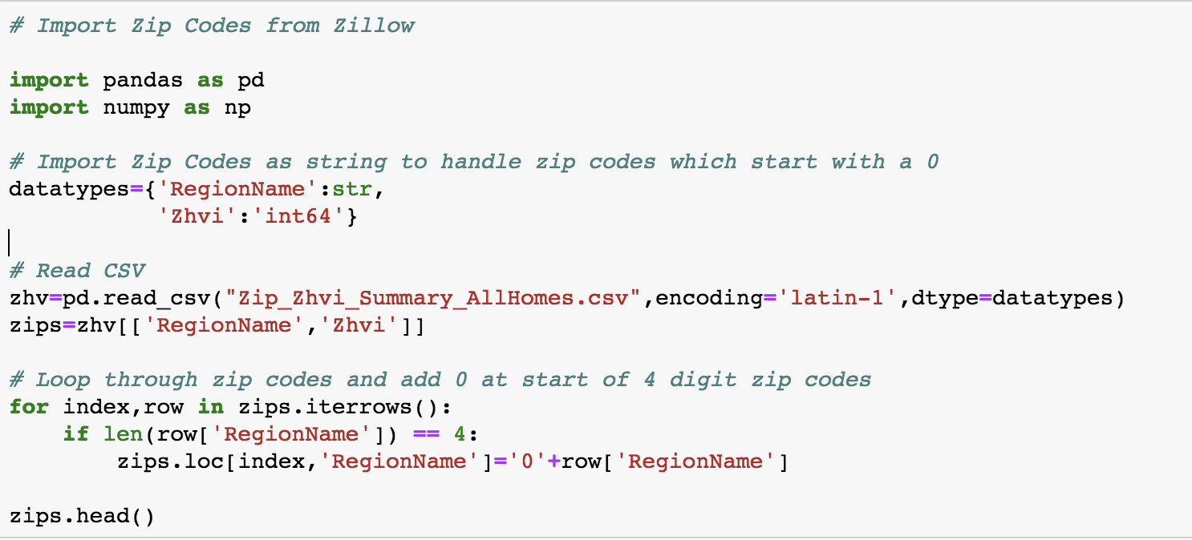
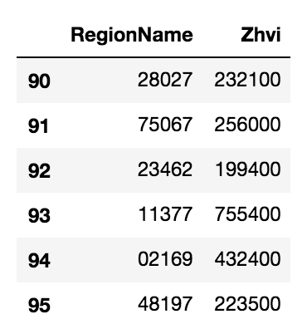
Data Exploration & Cleaning – Zip Codes
Notes:
Clint
No zip codes start with two 0’s (except PR)

Slide 4
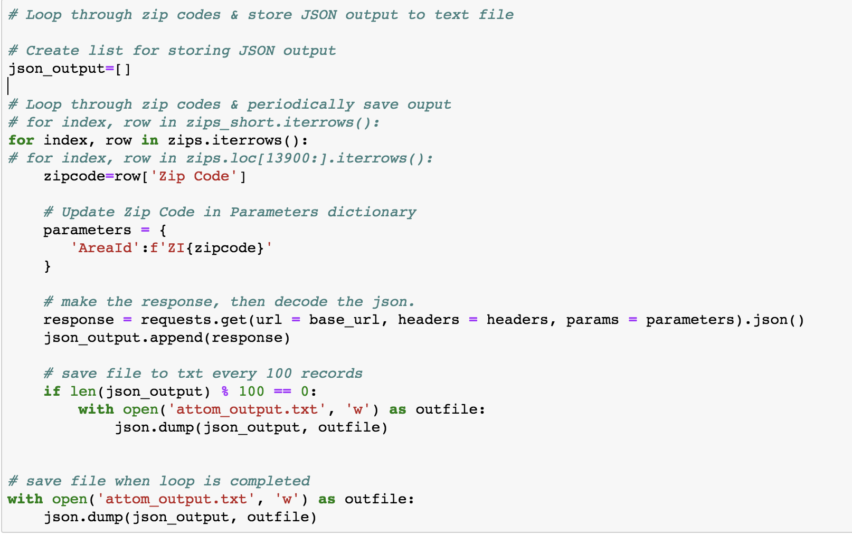
Data Exploration & Cleaning – Pulling from the API
Notes:
Ed

Slide 5
Data Exploration – Nationwide Coverage
Notes:
Clint

Slide 6
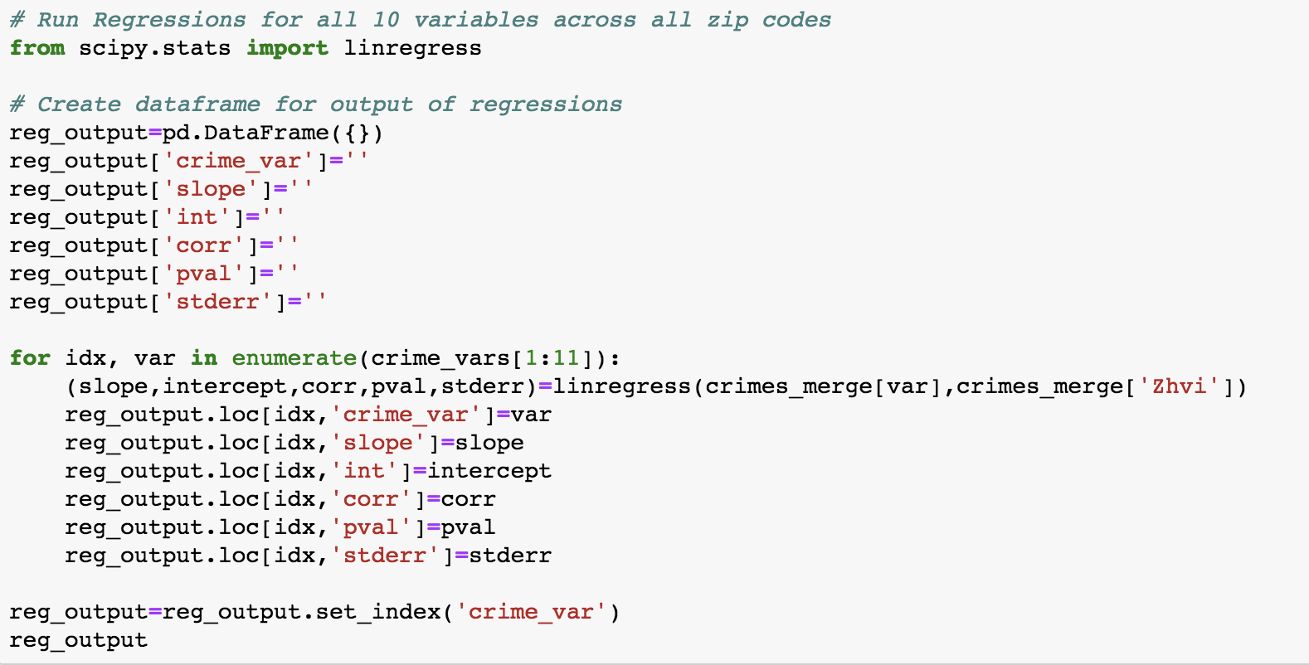
Analysis Process – Nationwide Level
Notes:
Ed

Slide 7
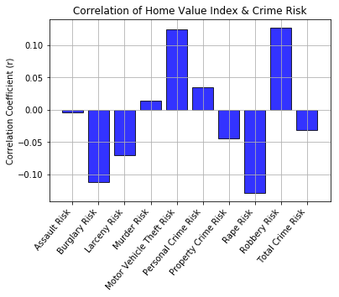
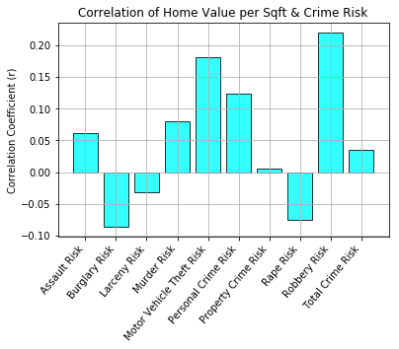
Analysis – Correlation by Crime Variable
Notes:
Ed

Slide 8
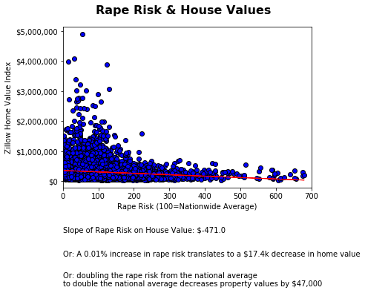
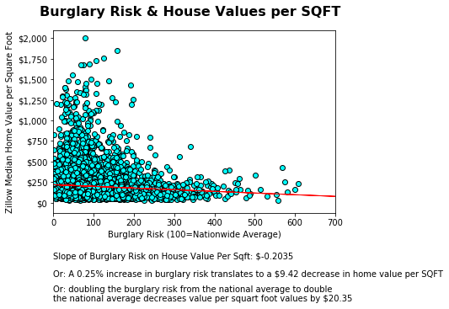
Analysis - Linear regression of Rape Risk on Zillow Home Value Index
Notes:
Clint

Slide 9
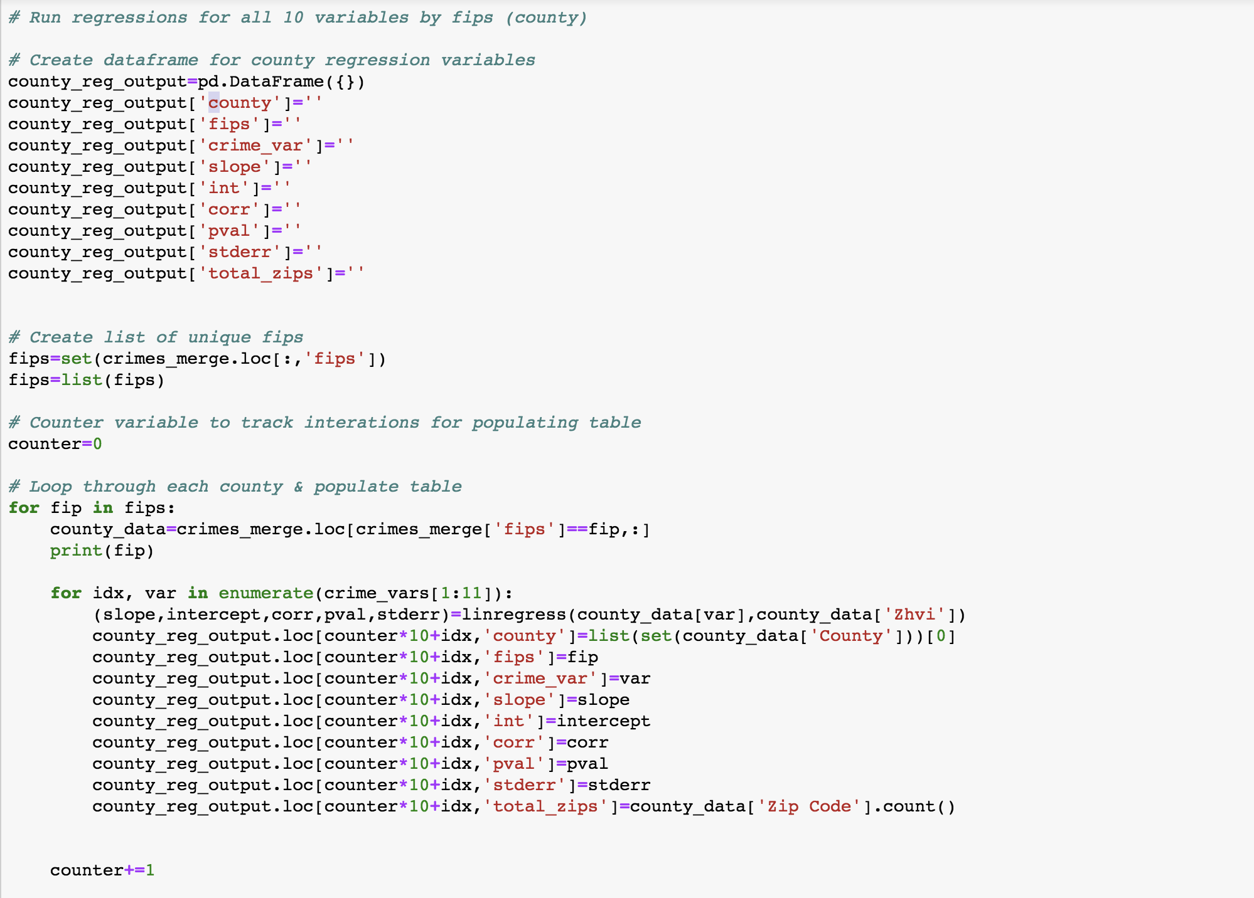
Analysis Process – County Level
Notes:
Ed

Slide 10
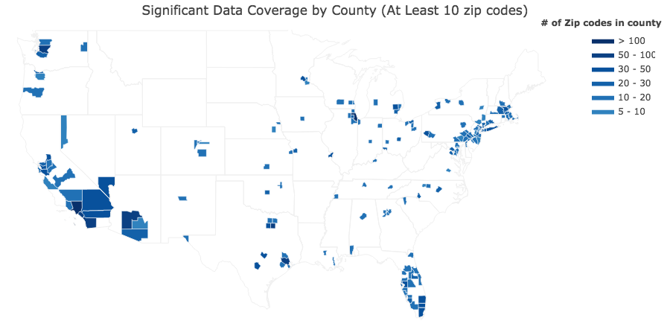
Data Exploration – sufficient data at County Level
Notes:
Ed

Slide 11
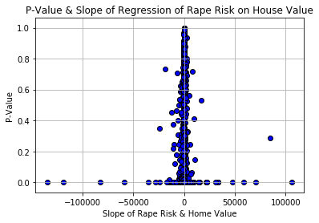
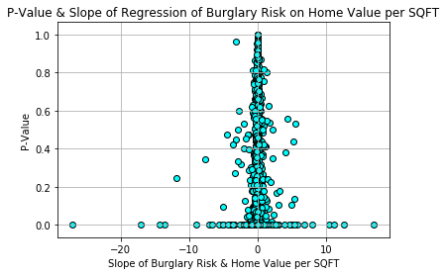
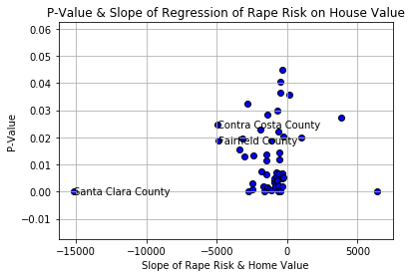
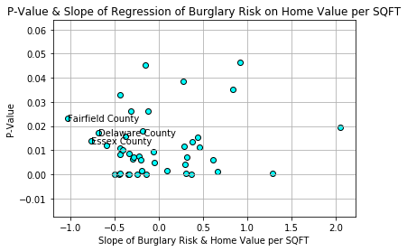
Analysis – All Counties vs Significant Counties
Notes:
Ed

Slide 12
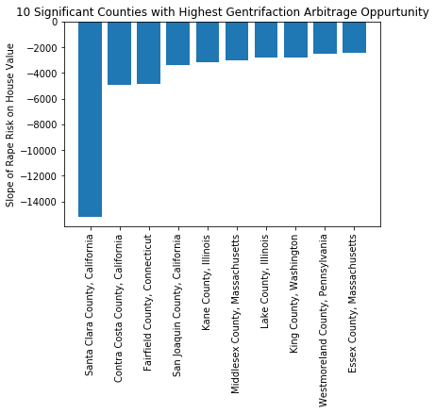
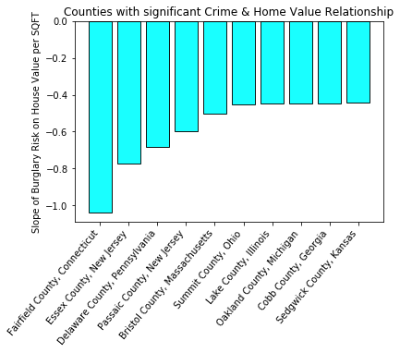
Analysis – Highest slope of Significant Counties
Notes:
Clint

Slide 13
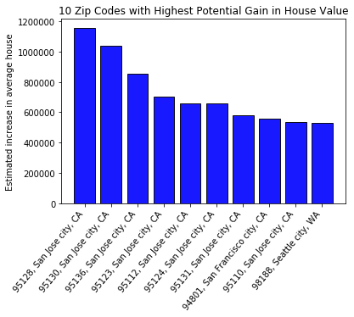
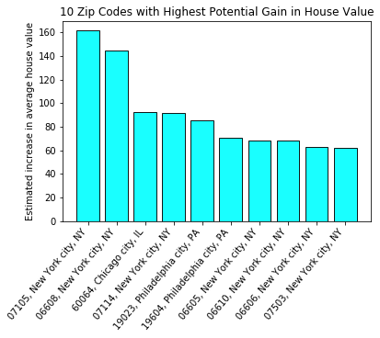
Analysis – Zip Codes most standing to gain value
Notes:
Ed

Slide 14
Conclusion
Zillow Home Value Index:
Rape Risk has the most significant relationship with housing values
Santa Clara County has the highest opportunity for opportunistic real estate
Zip Codes in San Jose are the highest opportunity for opportunistic investing
Median price per square foot:
Burglary Risk has the most significant relationship with housing values per square foot
Fairfield County, CT has the highest opportunity for opportunistic real estate
Zip Codes in New York are the highest opportunity for opportunistic investing
Notes:
Ed & Clint

